Slide 1
Downscaling techniques for retrieval of near-surface meteorological fields and turbulence parameters from atmospheric numerical model outputs
Jeremy A. Gibbs
School of Meteorology

Slide 2
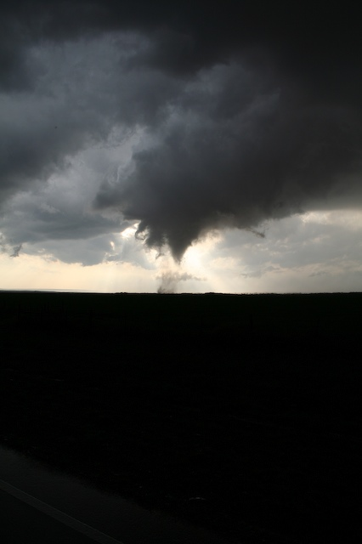
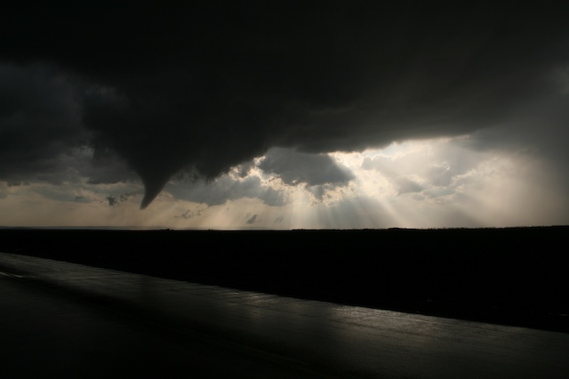
TORNADOES!!!!!

Slide 3
Introduction
The WRF model is evolving toward a self-contained NWP system, seemingly capable of modeling atmospheric motions encompassing global to fine scales
The promise of such capability is appealing to both operational and research environments
Air pollution, EM/acoustic wave propagation, etc…
How best to adequately represent small-scale atmospheric motions in the range of scales O(≤ 100m) based on numerical model output, remains a topic of debate
Notes:
- Air pollution applications rely on accurate representation of the dispersive role of small-scale motions.
- Propagation of electromagnetic and acoustic waves in the atmosphere, for which structure-function parameters are highly dependent on atmospheric turbulence
- CBL dynamics, the impact of urban regions on local microclimate, thunderstorm initiation and maintenance, and the influence of land characteristics on exchanges between the atmosphere and underlying surface

Slide 4
Introduction
Several methods were evaluated to reproduce realistic near-surface flow fields and turbulence parameters
WRF model (mesoscale mode; ∆=1 km, 4 km)
WRF model (LES mode; WRF-LES, ∆=20 m, 40 m)
RUC model (∆=20 km) → traditional LES (OU-LES)
WRF model (∆= 4 km) → traditional LES (OU-LES)

Slide 5
Mesoscale Approach
Scales of motion associated with atmospheric turbulence are not resolved on mesoscale grid meshes
Combined effects of subgrid turbulent motions on the mean fields must be modeled
Horizontal mixing ~ deformation of the resolved flow
Vertical mixing is parameterized using PBL schemes
assume that an individual model grid cell contains a representative sample of subgrid turbulent motions.
4 PBL schemes examined
YSU, MYJ, MYNN, TEMF
Notes:
Cheapest option

Slide 6
Setup
WRF
101 x 101 x 41 (∆x = ∆y = 1 km)
Initialized with NARR data (∆ ~ 32 km)
12-hr warm-start to reduce spin-up effects
OU-LES
512 x 512 x 80 (∆x = ∆y = 100 m, ∆z = 50m)
Nudged with RUC data (∆ ~ 20 km)
Observations (ARM facility - Lamont, OK)
surface meteorological observation system (SMOS)
eddy correlation flux measurement sys- tem (ECOR)
carbon dioxide flux measurement system (CO2FLX)
Notes:
WRF: 1st model level at 8m

Slide 7
Setup

Slide 8
Mesoscale: Discussion
Expanded work from past study (Gibbs et al. 2011)
increased from 2 to 5 CBL cases
investigated two new PBL schemes (MYNN, TEMF)
Little value added in move from 4 to 1 km
These scales often reside within the maximum energy-containing (turbulence producing) spectral intervals of CBL motions
flow features are potentially neither sufficiently resolved explicitly nor correctly represented statistically as subgrid-scale phenomena (Wyngaard 2004)
Notes:
Cheapest option
Limitations surrounding computational resources, observational data, and operational considerations often restrict the use of eddy-resolving numerical grids to small geographic regions. One popular compromise is the use of mesoscale numerical weather prediction (NWP) models

Slide 9
Mesoscale Discussion
WRF mean fields compared reasonably well with observational and LES data
some issues with shallow PBL and cool bias
Turbulence parameters indicated WRF generally could not capture the small-scale spatial variability of CBL flows
Non-local PBL scheme (YSU) performed the most admirably across a broad range of conditions
findings match other studies (Shin and Hong 2011)

Slide 10
LES Approach
Historically, the LES approach has proven particularly relevant for the reproduction of CBL flow types
Governing equations are separated into large-scale and small-scale eddies by means of a spatial filter
Large eddies explicitly calculated on numerical grid
Effects of small eddies on resolved flow must be modeled
Small eddies assumed homogeneous and isotropic
More favorable to generalized modeling
Given sufficient resolution, LES is assumed independent of SFS model
Notes:
As eddies undergo cascade, they become more amenable

Slide 11
Idealized LES
CBL flows were reproduced using a traditional LES code (OU-LES; Fedorovich et al. 2004a,b) and the WRF model applied in an LES mode (WRF-LES)
Velocity spectra and other statistics compared

Slide 12
Model Descriptions
 | OU-LES | WRF-LES
Governing Equations | Incompressible, Boussinesq | Compressible, Non-hydrostatic
Finite Difference Scheme | 2nd-order centered | 5th-order upwind
Integration Scheme | 3rd-order Runge-Kutta | 3rd-order Runge-Kutta (time-split)
Subgrid Scheme | 1.5-order TKE
Lateral Boundary Conditions | Periodic

Slide 13
Filters: Advection
5th-order scheme = 6th-order + implicit diffusion term
Diffusion term proportional to the Courant number
Notes:
Skamarock (2004)

Slide 14
Filters: RK3 (acoustic modes)
Time-averaging of vertically-implicit part of time-split equations slightly forward-centered
Notes:
Skamarock (2004)

Slide 15
Filters: RK3 (acoustic modes)
Terms added to horizontal momentum equations that specifically damp 3D divergence (in terms of time derivative of pressure)
Modified pressure used in horizontal pressure-gradient terms
Notes:
Skamarock (2004)
This modification is equivalent to inserting a horizontal diffusion term into the equation for the 3D mass divergence, hence the name divergence damping.

Slide 16
Filters: RK3 (external modes)
Terms added to horizontal momentum equations that damp the vertically-integrated horizontal divergence
Notes:
Skamarock (2004)
Taking horiz. Divergence and integrating vertically yields a 2nd-order diffusion term.

Slide 17
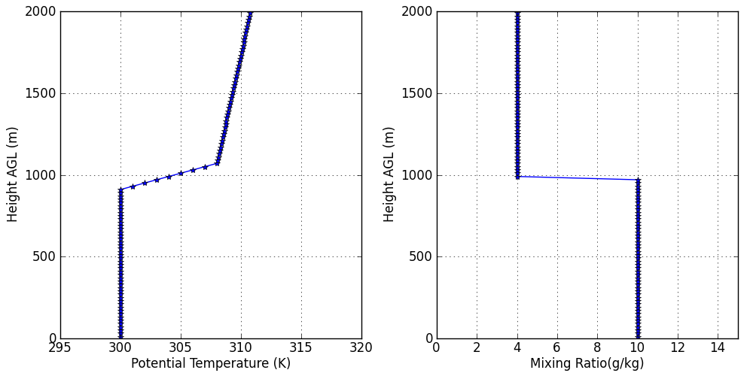
Idealized Setup
Numerical domain: 10.24×10.24×2 km³
Initialized with same idealized profiles
CBL forcings were set equal and held constant
Effects of flow types (with/without shear) and of varying isotropic grid spacing (20/40/80 m) were investigated
Notes:
Profiles from WRF idealized LES test cases.
Heat flux & moisture flux ~125 W/m^2
coriolis is applied as f(u-ubase), where f=1e-4 and ubase is initial (and presumably geostrophically balanced) profile.

Slide 18
Why Spectra?
Lack of verification data at these scales
Can indicate whether a model produces expected energy statistics
This in turn indicates whether a model produces features consistent with realistic atmospheric dynamics
Further allows investigation of model numerics and assessment of effective resolution
Notes:
Skamarock (2004)

Slide 19
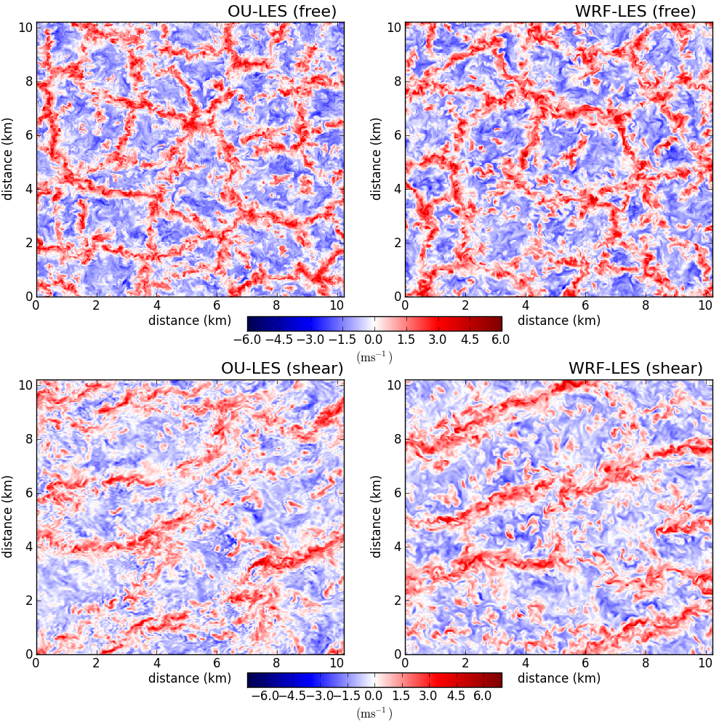
w-component velocity (z/zi=0.25)
Notes:
Sample slice of final hour. Looks similar, right? Some signs of broader, less organized cellular convection for free, and slightly broader and elongated streaks in shear.

Slide 20
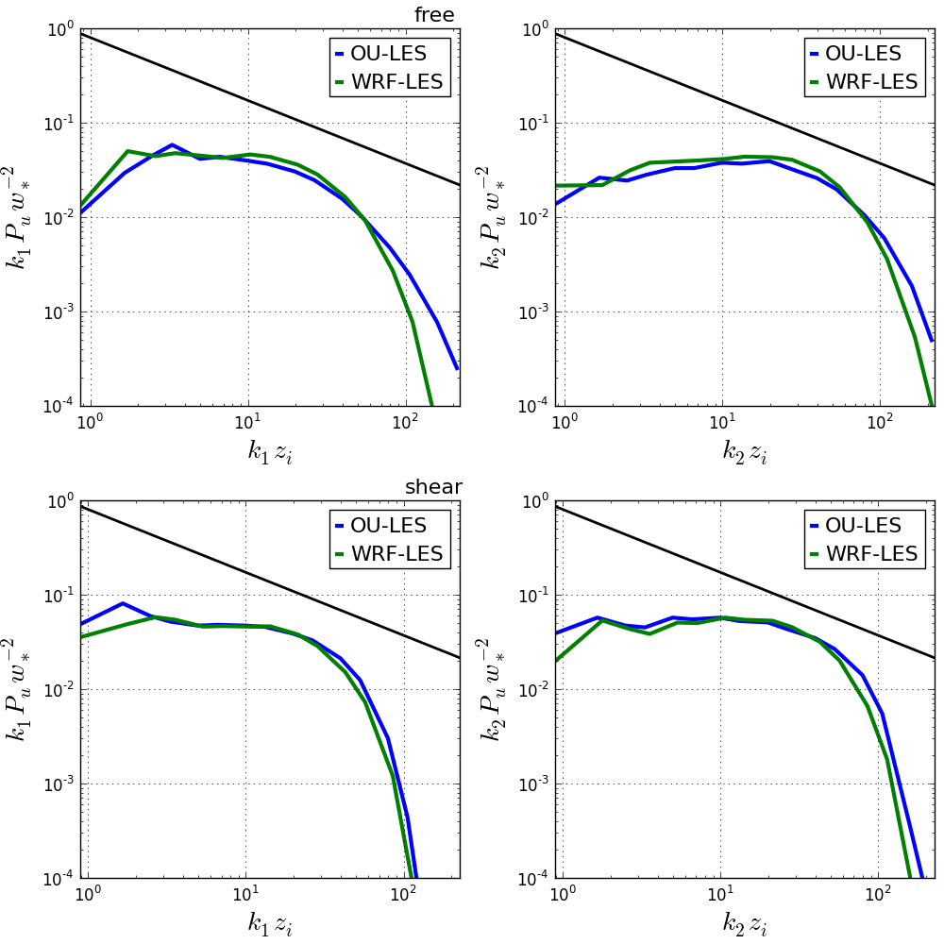
u-component: 1D spectral density (z/zi=0.25)
Notes:
Free: both have narrower inertial sub-range and much sharper drop-off, more energy at larger scales
Shear: similar, but still drops off faster, transverse worse

Slide 21
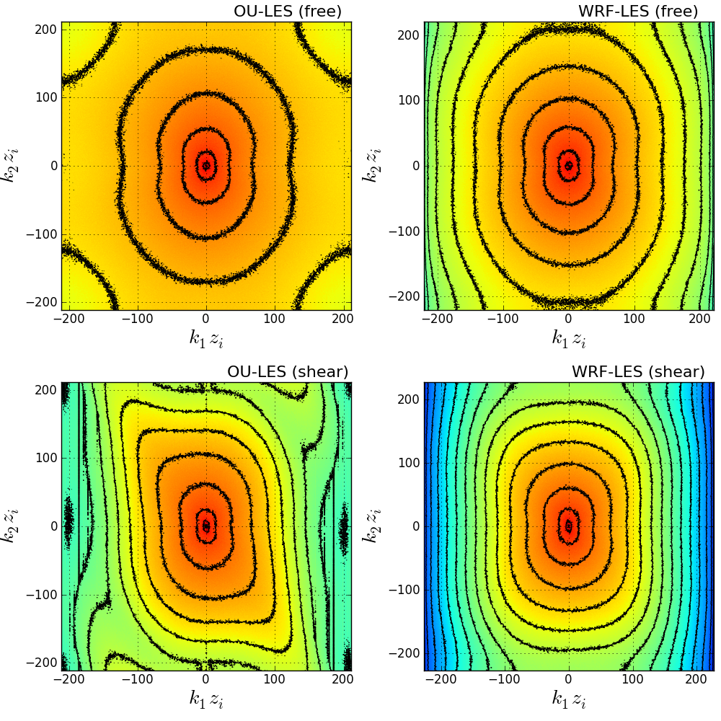
u-component: 2D spectral density (z/zi=0.25)
Notes:
Note: elongated in transverse direction due to theory ~4/3 t/l
Free: WRF more concentrated near larger scales, and fast drop-off
Shear: Not as concentrated near larger scales, but drop-off occurs at smaller scales.
Note, spectra shifted in k2 direction, due to variability across rolls, these are small scale anisotropic effects that WRF washes out

Slide 22
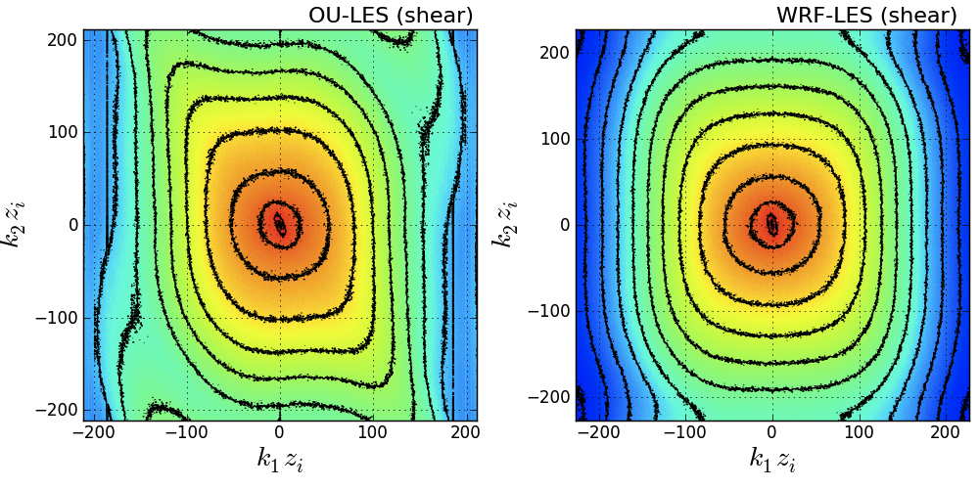
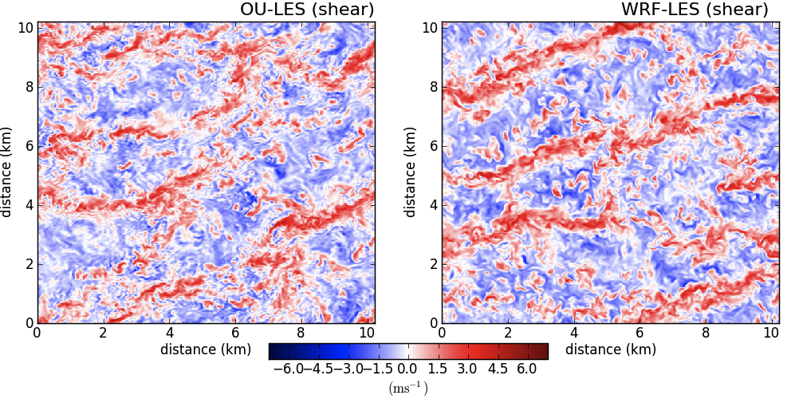
Notes:
For instance, air pollution applications, where dispersive role of small-scale motion may be very important, or wave propagation business, where structure-function parameter will not be right if small-scale motions are affected by numerical dissipation.

Slide 23
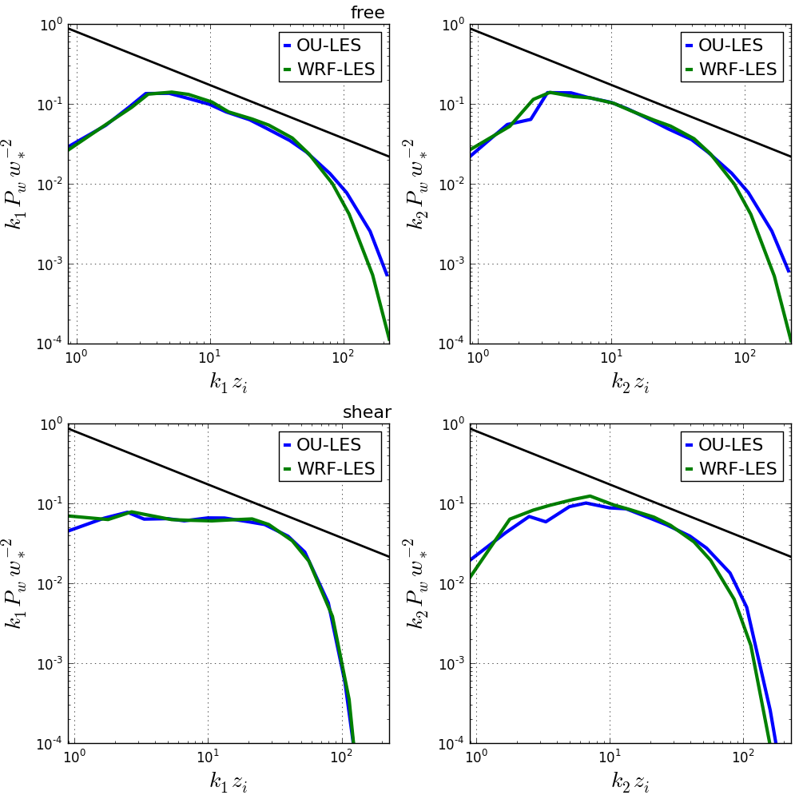
w-component: 1D spectral density (z/zi=0.25)
Notes:
Free: both have narrower inertial sub-range and much sharper drop-off, more similar energy at larger scales
Shear: k1 direction almost matches exactly, in k2 direction get larger drop-off more energy at larger scales

Slide 24
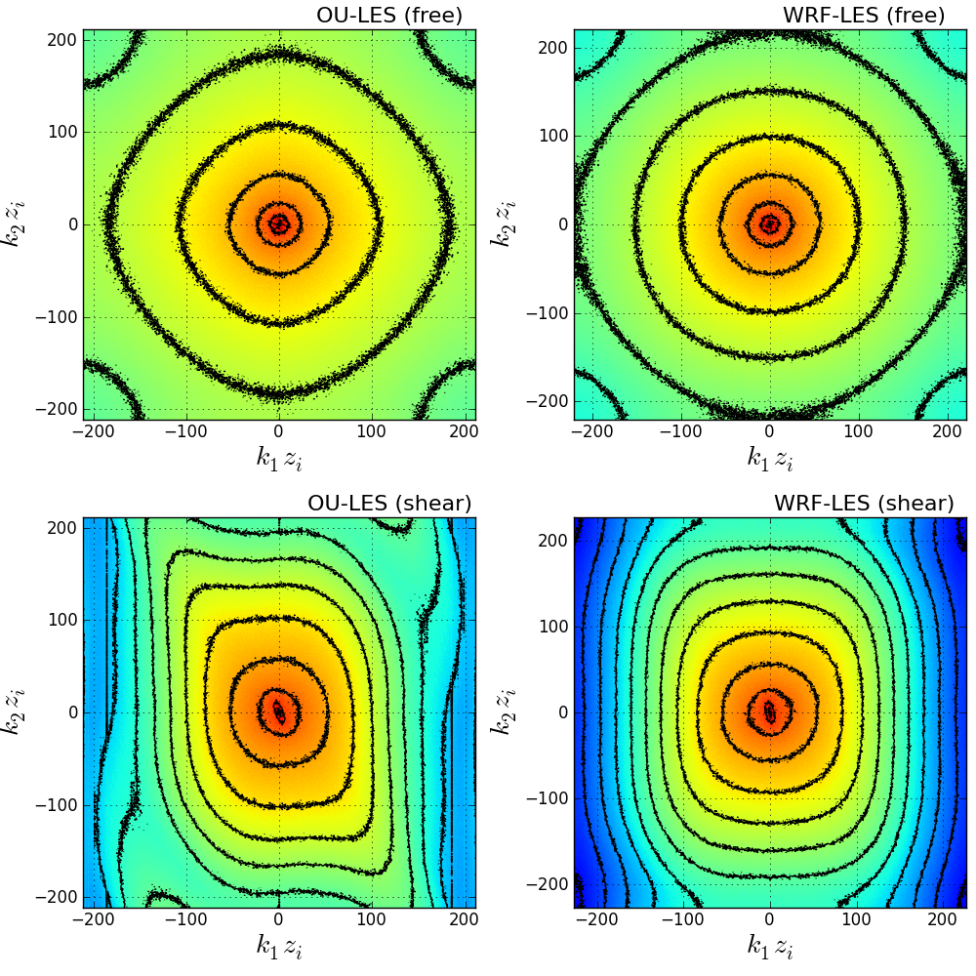
w-component: 2D spectral density (z/zi=0.25)
Notes:
Note: not elongated because k1,k2 are both transverse
Free: WRF less more concentrated near larger scales, and fast drop-off
Shear: Not as concentrated near larger scales, but drop-off occurs at smaller scales.
Note, spectra shifted in k2 direction, due to variability across rolls, these are small scale anisotropic effects that WRF washes out

Slide 25
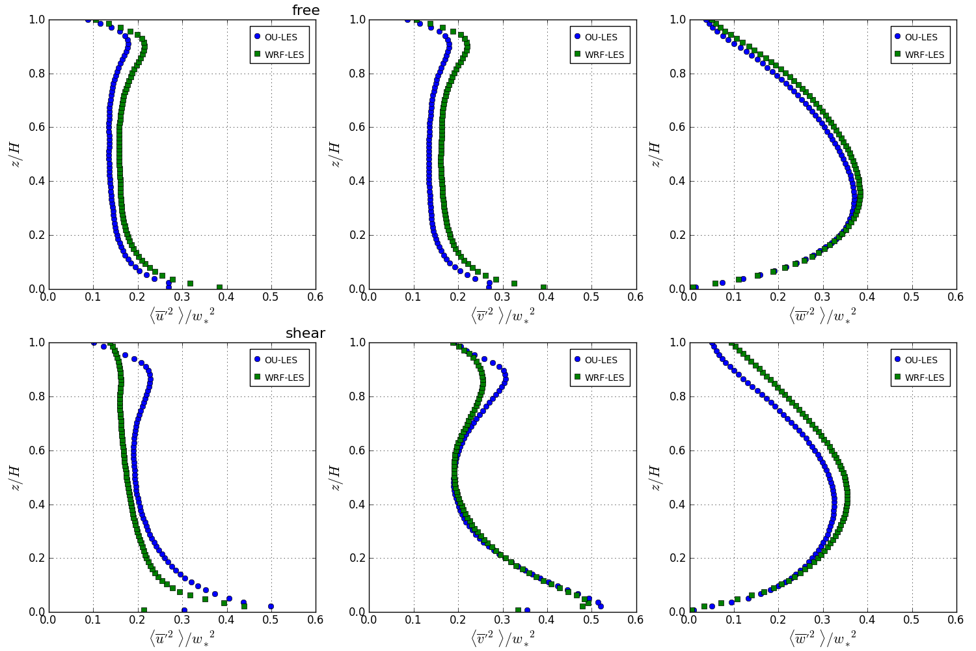
normalized velocity variance
Notes:
Free: u: WRF larger v: WRF larger w: similar at level of interest
Shear: u: OU larger v: similar w: WRF maybe slightly more at level of interest

Slide 26
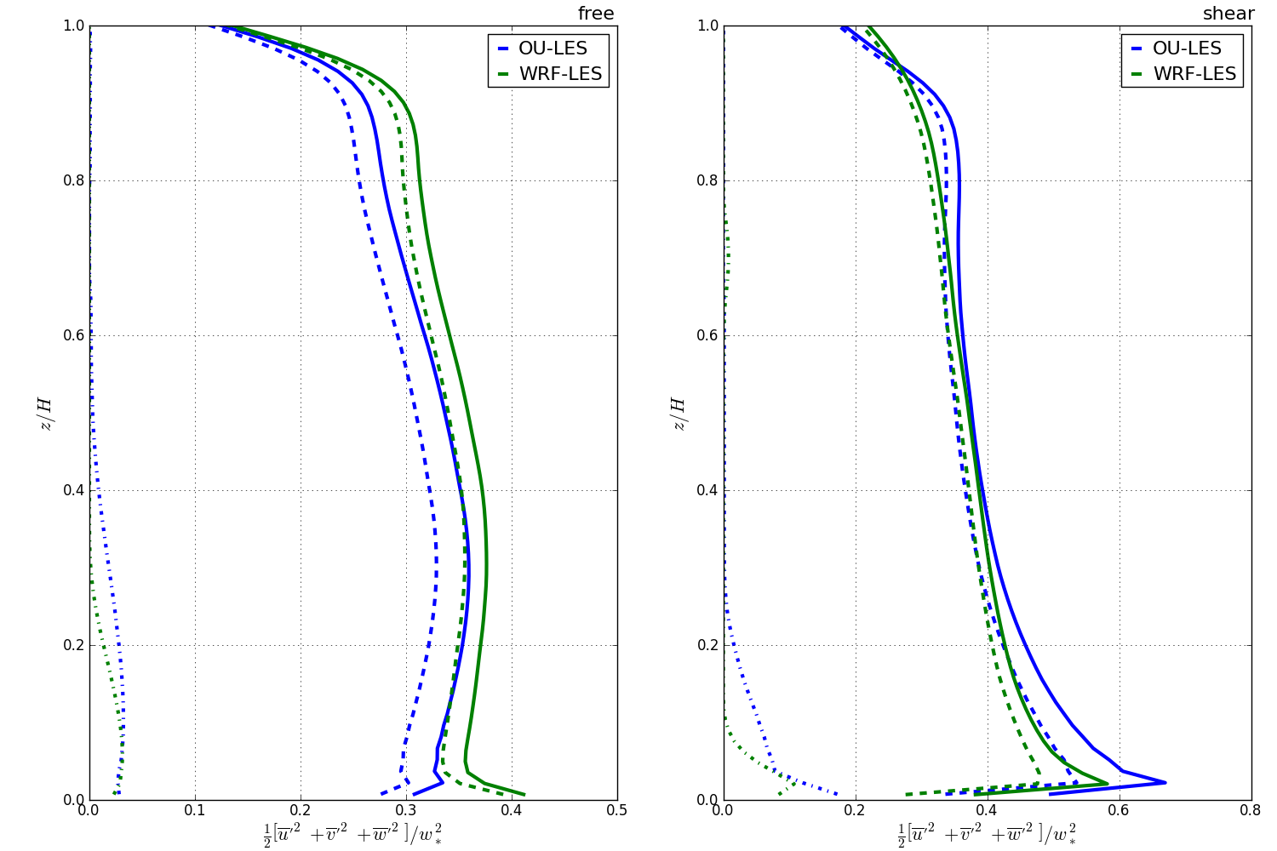
normalized turbulence kinetic energy
Notes:
Free: tke: WRF larger
Shear: tke: OU larger

Slide 27
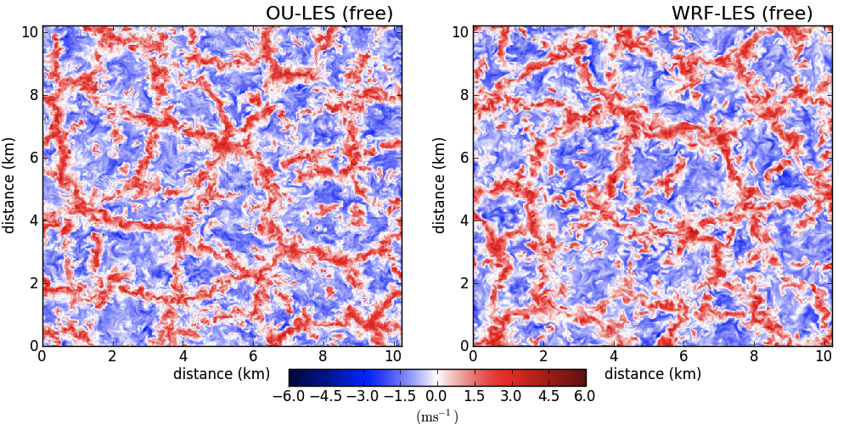
Discussion: Shear-Free
Visually, velocity patterns look similar

Slide 28
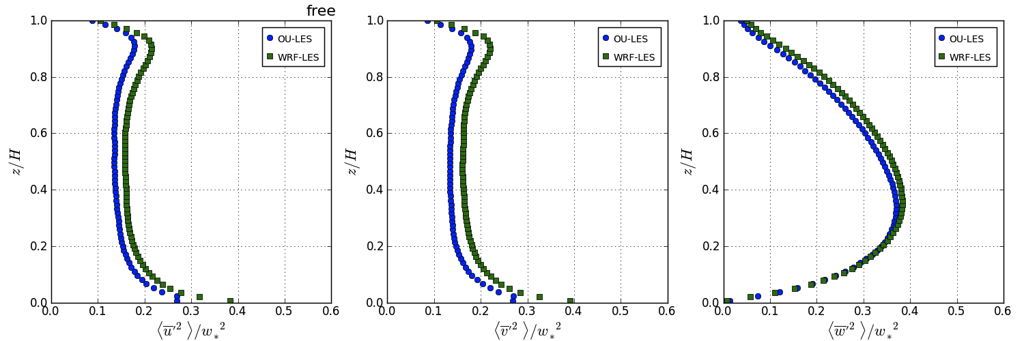
Discussion: Shear-Free
WRF-LES produced larger velocity variances, larger TKE
Notes:
For instance, air pollution applications, where dispersive role of small-scale motion may be very important, or wave propagation business, where structure-function parameter will not be right if small-scale motions are affected by numerical dissipation.

Slide 29
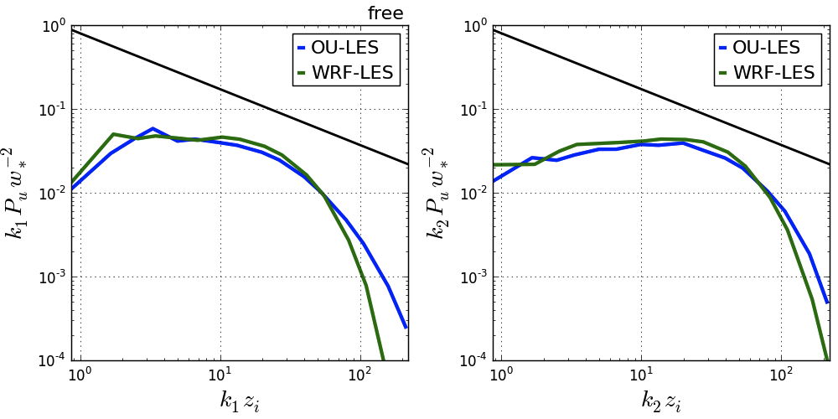
Discussion: Shear-Free
Spectra show that energy attributed to larger scales in WRF-LES as compared to OU-LES
Notes:
For instance, air pollution applications, where dispersive role of small-scale motion may be very important, or wave propagation business, where structure-function parameter will not be right if small-scale motions are affected by numerical dissipation.

Slide 30
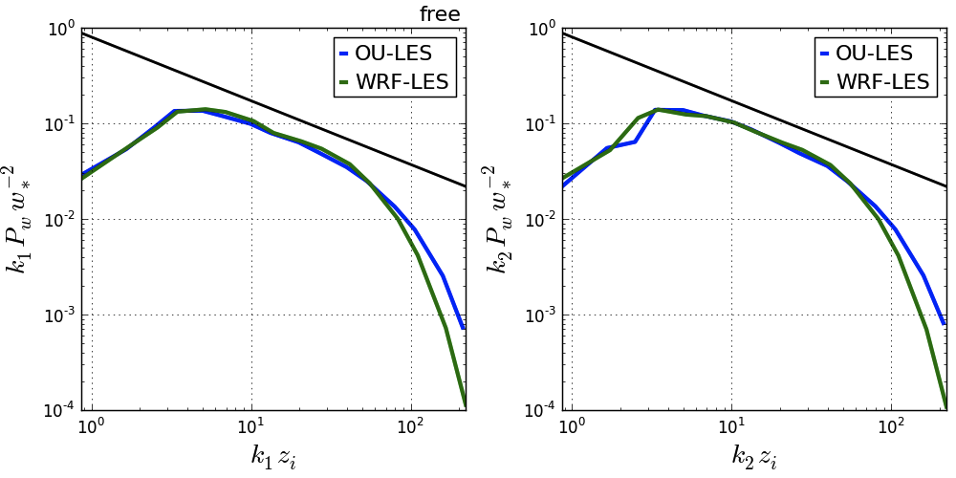
Discussion: Shear-Free
WRF-LES had slightly narrower inertial sub-range, less effective resolution, and sharper drop-off at high frequencies

Slide 31
Discussion: Shear-Driven
Visually, velocity patterns look similar

Slide 32
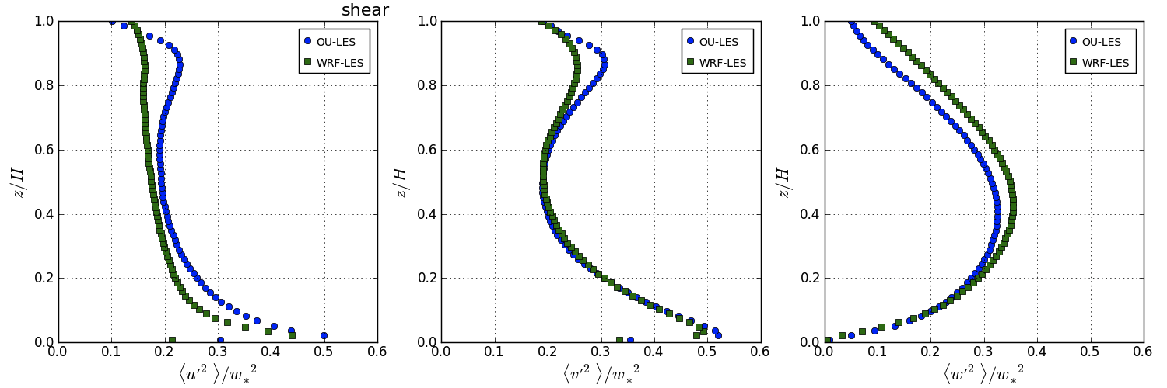
Discussion: Shear-Driven
WRF-LES produced smaller u-variance, TKE, & momentum flux - larger velocities

Slide 33
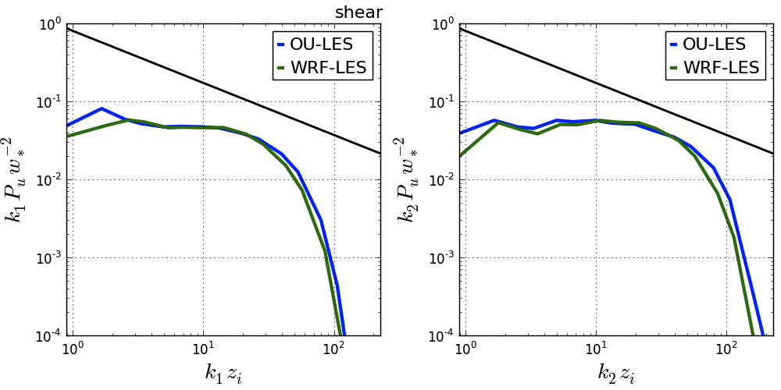
Discussion: Shear-Driven
Spectra show that k₁ spectra match more closely, but for k₂, similar behavior as in shear-free case
Notes:
For instance, air pollution applications, where dispersive role of small-scale motion may be very important, or wave propagation business, where structure-function parameter will not be right if small-scale motions are affected by numerical dissipation.

Slide 34
Discussion: Shear-Driven
2D spectra indicate that shear-induced, anisotropic effects are smudged out at small scales in WRF-LES
Notes:
For instance, air pollution applications, where dispersive role of small-scale motion may be very important, or wave propagation business, where structure-function parameter will not be right if small-scale motions are affected by numerical dissipation.

Slide 35
Idealized Summary
WRF-LES suffers from excessive numerical dissipation at small scales
appears dependent on dominant flow type
may result from filters inherent to WRF dynamics solver
possibly affects larger scales
LES expensive option depending on code/resources
WRF-LES (512x512x80, ∆=20 m) ~ 1200 proc. & 45 hrs.
OU-LES (512x512x80, ∆=20 m) ~ 1 proc. & 8-10 days
Output files O(1TB)

Slide 36
Real-Data LES: Problems
Lateral boundaries are assumed periodic
condition rarely met in the atmosphere
Domains are generally disconnected from large-scale forcings and local terrain properties
predictions are susceptible to drift from observations and often fail to reproduce sharp gradients observed in nature (Botnick & Fedorovich 2008; Conzemius & Fedorovich 2008)
OU-LES, for example, uses lower-order advection schemes
dispersive errors
Notes:
Can grow unbounded from observations

Slide 37
Real-Data LES: Solutions
WRF in supported LES mode (WRF-LES)
specified boundaries
higher-order advection scheme
can be nested within mesoscale domain (one-stop shop)
OU-LES (nudged)
connects LES with realistic data from the larger-scale environment
retains local variability by only modifying background environment
Notes:
Cheapest option

Slide 38
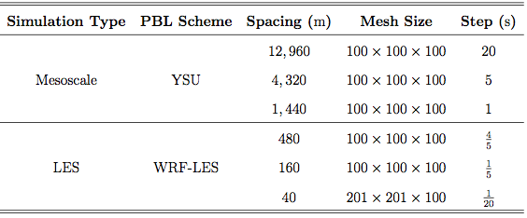
WRF-LES: Setup
Split nesting procedure needed to satisfy physics requirements (Talbot et al. 2012)
3 mesoscale domains → 3 LES domains
Notes:
Requires sgs model to match across nests.

Slide 39
OU-LES: Setup
Domain matches inner WRF-LES domain
centered over Lamont, OK
201 x 201 x 100 (∆ = 40 m)
RUC analyses (∆ = 20 km)
nearest four grid cells to Lamont site are averaged
available every hour
WRF mesoscale output (∆ = 4 km)
nearest four grid cells to Lamont site are averaged
available every minute
Notes:
Cheapest option

Slide 40
OU-LES: Setup
Nudging profiles linearly interpolated in time to current time step
subtracted from plane-averaged LES profiles
Nudging tendency is applied at next time step
nudging factor → adjustment on a time scale between the convective and diurnal time scales
Only modifies background environment
local variability retained
Notes:
Cheapest option

Slide 41
Case 1: June 7, 2007

Slide 42
Case 1: meteogram
Notes:
Sample slice of final hour. Looks similar, right? Some signs of broader, less organized cellular convection for free, and slightly broader and elongated streaks in shear.

Slide 43
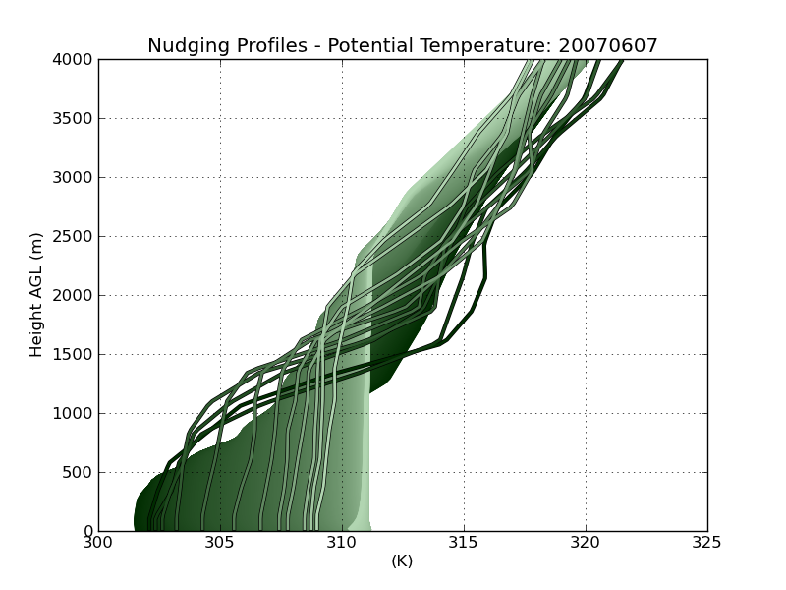
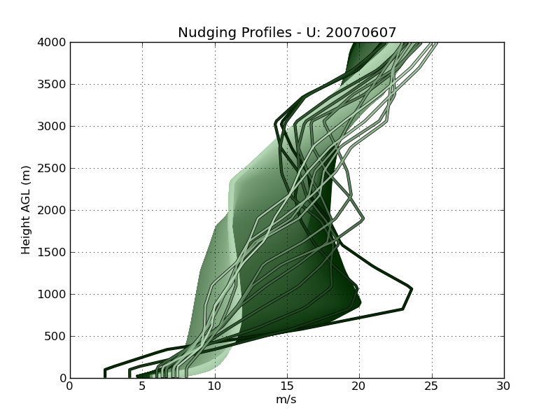
Case 1: nudging profiles
Notes:
Cheapest option

Slide 44
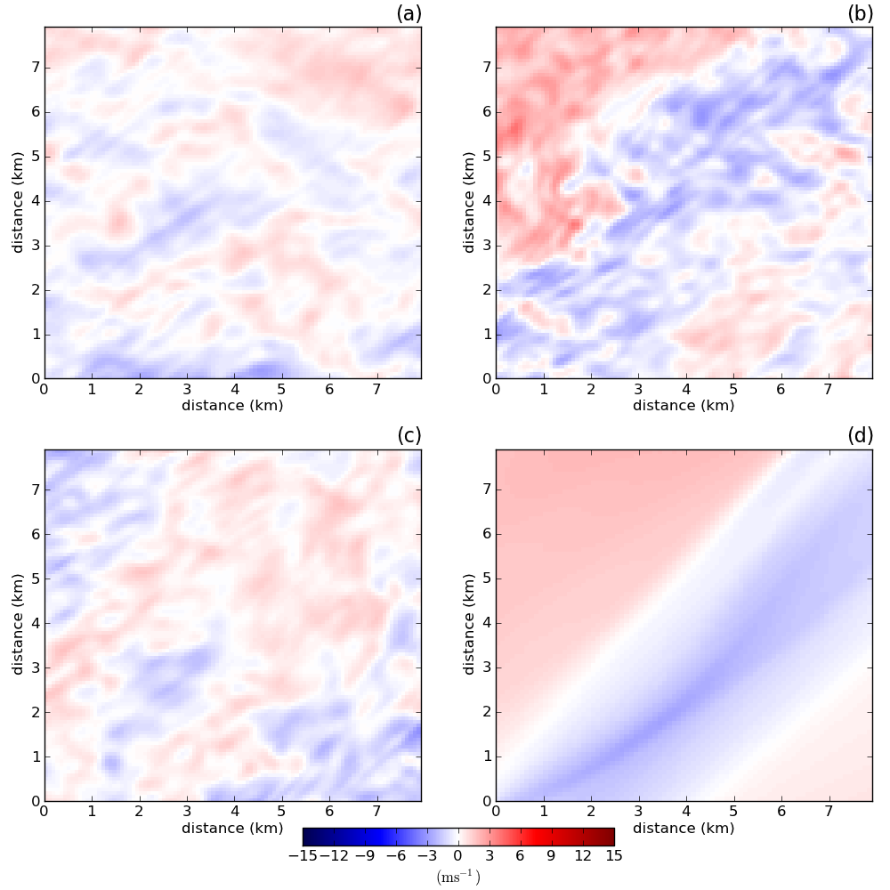
Case 1: u-component velocity (z/zi=0.25)
Notes:
Sample slice of final hour. Looks similar, right? Some signs of broader, less organized cellular convection for free, and slightly broader and elongated streaks in shear.

Slide 45
Case 1: u-component 1D spectral density (z/zi=0.25)
Notes:
Sample slice of final hour. Looks similar, right? Some signs of broader, less organized cellular convection for free, and slightly broader and elongated streaks in shear.

Slide 46
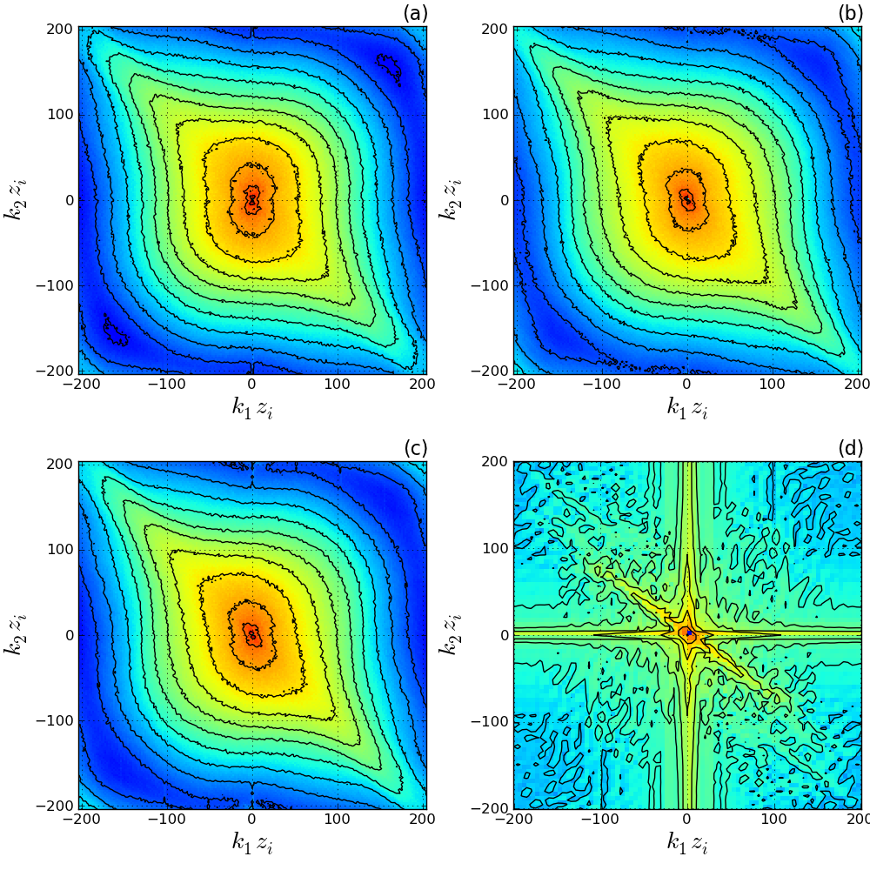
Case 1: u-component 2D spectral density (z/zi=0.25)
Notes:
Sample slice of final hour. Looks similar, right? Some signs of broader, less organized cellular convection for free, and slightly broader and elongated streaks in shear.

Slide 47
Case 2: October 26, 2008

Slide 48
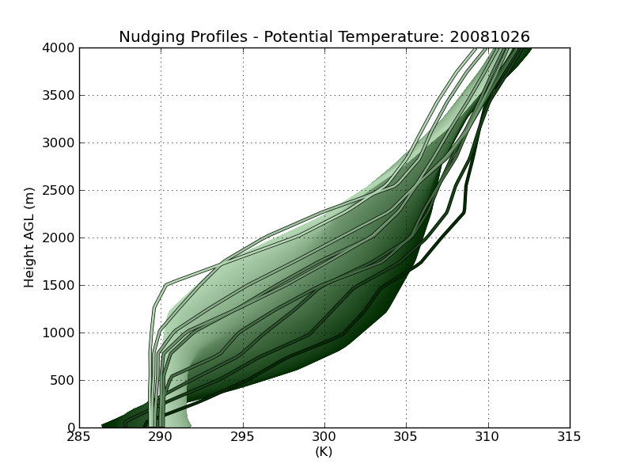
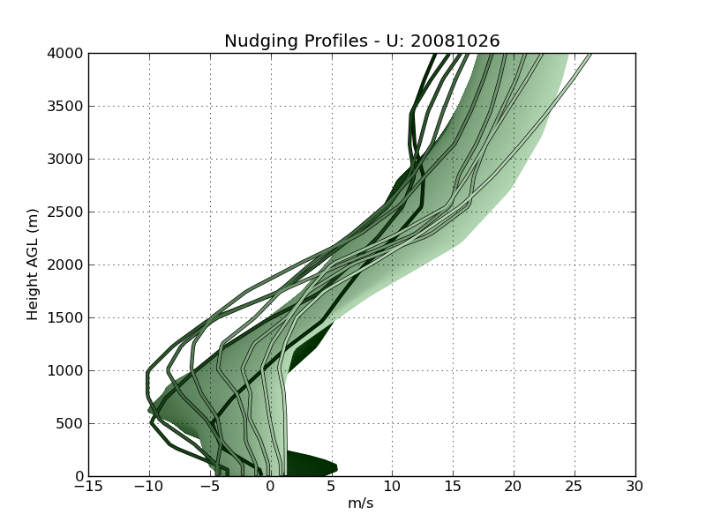
Case 2: nudging profiles
Notes:
Cheapest option

Slide 49
Case 2: meteogram
Notes:
Sample slice of final hour. Looks similar, right? Some signs of broader, less organized cellular convection for free, and slightly broader and elongated streaks in shear.

Slide 50
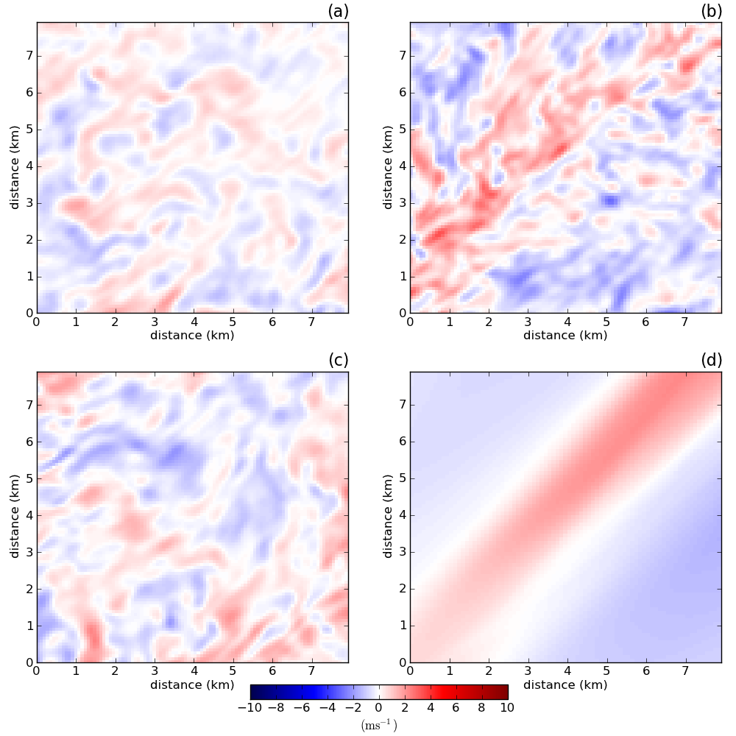
Case 2: u-component velocity (z/zi=0.25)
Notes:
Sample slice of final hour. Looks similar, right? Some signs of broader, less organized cellular convection for free, and slightly broader and elongated streaks in shear.

Slide 51
Case 2: u-component 1D spectral density (z/zi=0.25)
Notes:
Sample slice of final hour. Looks similar, right? Some signs of broader, less organized cellular convection for free, and slightly broader and elongated streaks in shear.

Slide 52
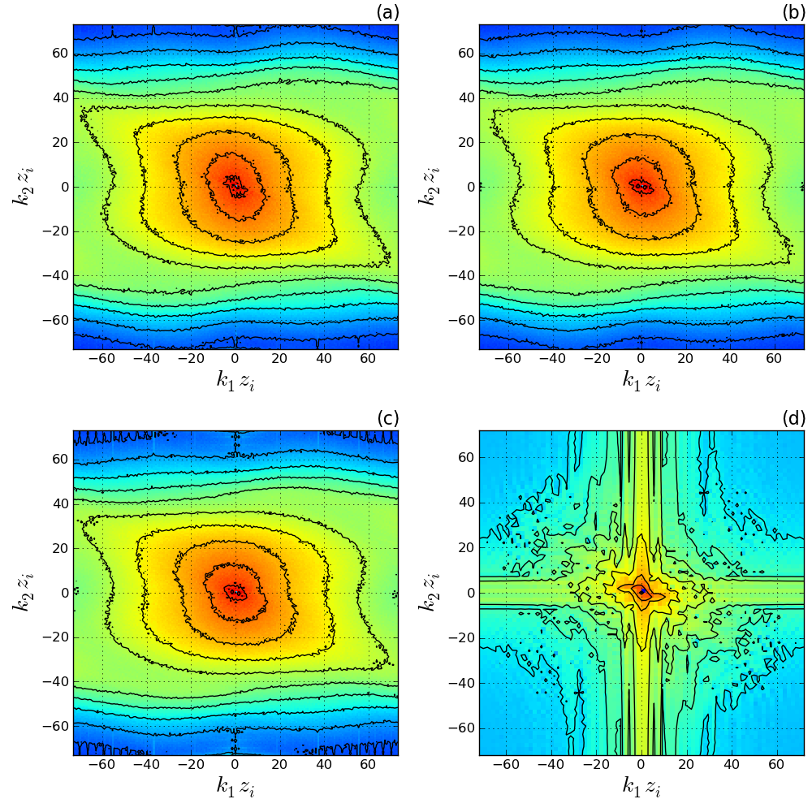
Case 2: u-component 2D spectral density (z/zi=0.25)
Notes:
Sample slice of final hour. Looks similar, right? Some signs of broader, less organized cellular convection for free, and slightly broader and elongated streaks in shear.

Slide 53
WRF-LES: Summary
Only two cases were shown due to instabilities in other cases
even with extremely conservative time step, WRF-LES domains would crash
possibly due to limits on time step and the initial transition into turbulent flow
Expensive option to run six nests
mesoscale domains cheap and fast
LES domains ~ 384 proc. & 40 hours

Slide 54
WRF-LES: Summary
Mean near-surface fields generally compared favorably with observational and OU-LES data
Horizontal slices were another story
big streaks, no small-scale variability associated with atmospheric turbulence
Resulting high-order statistics (spectra, variances, etc..) were corrupted
spectra showed no expected cascade
variances were grossly exaggerated
WRF-LES fails to adequately reproduce spatial variability within sufficiently broad scale ranges

Slide 55
WRF-LES: Summary
Behavior possibly due to boundary effects described in previous studies (Moeng et al. 2007; Mirocha 2010)
matching subgrid closures across scales presents issues
coarse domains do not sufficiently resolve TKE to pass to inner domains, inner domains must spin-up
outer LES domains likely within problematic scale range, so inner domain is passed insufficient flow features
Effects from model numerics may also pose a problem
Required tradeoffs may limit the applicability of WRF-LES in particular real-data scenarios

Slide 56
OU-LES: Summary
Nudging procedure allows for improvement in mean near-surface fields, while retaining turbulence structures that OU-LES is known to confidently reproduce
Overall, the higher-resolution (in space and time) WRF-nudged simulations best accomplish this task
The extent to how applicable this nudging procedure is across scales and differing geographic locations remains a question for future study
WRF-Nudged OU-LES represents a best compromise in generating accurate bulk meteorological quantities and realistic turbulence statistics across a broad range of turbulence scales.

Slide 57
Summary: TRADEOFFS!
WRF-LES solves more physically robust equations, but filters affect scales of interest (and maybe others)
WRF-LES uses a higher-order advection scheme, but implicit diffusion term may also affect scales of interest
OU-LES uses periodic LBCs, which isn’t as physically relevant. But specified boundaries and nesting in WRF-LES affect scales of interest
OU-LES may then be nudged, but the implementation is rather ad-hoc – the applicability across a wide range of scales and locations is unknown

Slide 58

Summary

Slide 59
Additional Slides

Slide 60
YSU PBL Scheme
MOST surface layer scaling
Non-local (large scale eddies contribute to total flux)
Eddy diffusivity
Counter-gradient term
Entrainment
Notes:
Local-K in free atmosphere

Slide 61
MYJ PBL Scheme
MOST surface layer scaling
Local scheme (local gradients contribute to total flux)

Slide 62
MYNN PBL Scheme
MOST surface layer scaling
Local scheme w/ implicit non-local effects
Notes:
is the local rate of change in TKE
is the advection of TKE by the resolved flow
is the vertical redistribution of TKE (S_q = 3 S_m)
is shear production of TKE
is buoyancy production or destruction of TKE, and
is the TKE dissipation rate.

Slide 63
TEMF PBL Scheme
Non-MOST surface layer scaling (no constant flux)
Eddy diffusivity + mass flux
Notes:
Eddy diffusivity from total energy
Stability is first determined.
If the surface buoyancy flux is positive, then eddy diffusion is activated.
Energy budgets, appropriate length scales, and diffusion coefficients are calculated.
If surface heat flux is positive, then mass flux is activated.
An updraft is initialized and appropriate fractional entrainment/detrainment rates are computed
Finally, mass flux is calculated.

Slide 64
Subgrid Closure: 2D
Smagorinsky first-order closure
Eddy viscosities ∝ horizontal deformation
Notes:
Eddy diffusivity from total energy
Stability is first determined.
If the surface buoyancy flux is positive, then eddy diffusion is activated.
Energy budgets, appropriate length scales, and diffusion coefficients are calculated.
If surface heat flux is positive, then mass flux is activated.
An updraft is initialized and appropriate fractional entrainment/detrainment rates are computed
Finally, mass flux is calculated.

Slide 65
Subgrid Closure: 3D
Deardorff 1.5-order prognostic TKE closure
Notes:
is the local rate of change in STKE
is the advection of STKE by the resolved flow
is shear production of STKE
is buoyancy production or destruction of STKE
is the distribution of STKE through pressure and turbulent motions
is the STKE dissipation rate.
Takemi and Rotunno 2003 – differences in Ce don’t matter that much.

Slide 66
Case 1: Results

Slide 67
Case 1: Results

Slide 68
Case 1: Results

Slide 69
Case 2: Results

Slide 70
Case 2: Results

Slide 71
Case 2: Results

Slide 72
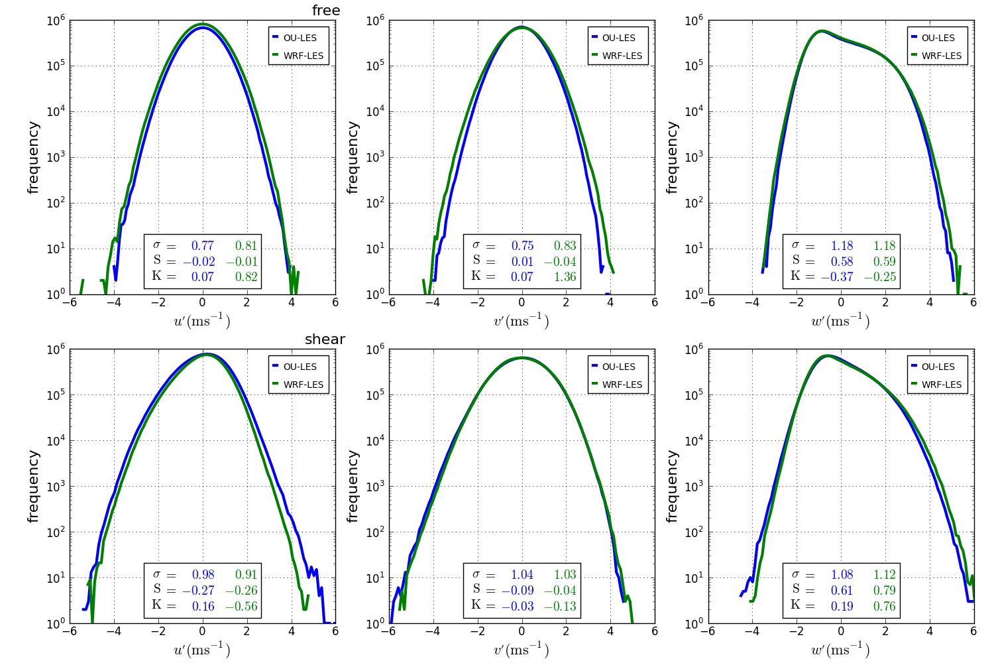
normalized velocity variance
Notes:
Free: u: wrf larger std, similar small negative skewnewss, wrf larger positive kurtosis
v: wrf larger std, ou slightly positive skewed – wrf negative skewness, wrf much larger positive kurtosis
w: same std, nearly same positive skewness, ou larger negative kurtosis
Shear: u: ou larger std, similar negative skewness, ou positive kurtosis, wrf larger negative kurtosis
v: nearly same std, ou larger negative skewness, wrf larger negative kurtosis
w: wrf slightly larger std, wrf larger positive skewness, wrf larger positive kurtosis

